Slide 1
St Mary’s College
World class thinking. World class achieving.
Year 10 - Steps to Success

Slide 2
Welcome
World class thinking. World class achieving.
Head of Year – Mr Dawson

Slide 3
Click to play video

Slide 4
Early entry
World class thinking. World class achieving.
Assistant Head – KS4 - Dr Wild

Slide 5
Click to play video

Slide 6
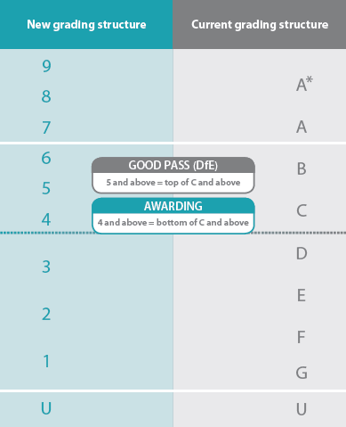
New GCSEs: An introduction
Reformed GCSEs are being introduced gradually over three years and started in September 2015.
They will be graded from 9 to 1, instead of A* to G. (Students taking GCSEs over this period will therefore receive a mixture of 9 to 1 and A* to G grades.)
Coursework has been largely removed and exams tend to be longer and greater in number.
Exams are linear (sat at the end of courses).
Figure a: Comparison of current and revised grading structures with reference points for analysis¹
World class thinking. World class achieving.

Slide 7
Click to play video

Slide 8
St Mary’s College
World class thinking. World class achieving.
English Language Exam-
Year 10 Information

Slide 9
English at SMC- Year 10 updates
All Year 10 students are working towards early entry for their GCSE English Language qualification.
What are the benefits of early entry?
What will my child have to do in their exams?
Language Paper 1: Explorations in Creative reading and writing
Language Paper 2: Writers’ viewpoints and perspectives
World class thinking. World class achieving.

Slide 10
Why?
Our results in English:
 | National | SMC Y11 2020 | SMC Y11 2019 | SMC Y11 2018
Students achieving Grade 4+ | 60% | 75% | 72% | 79%
Students achieving Grade 5+ | - | 59% | 56% | 55%
Students achieving Grade 7+ | 13% | 16% | 14% | 15%
World class thinking. World class achieving.

Slide 11
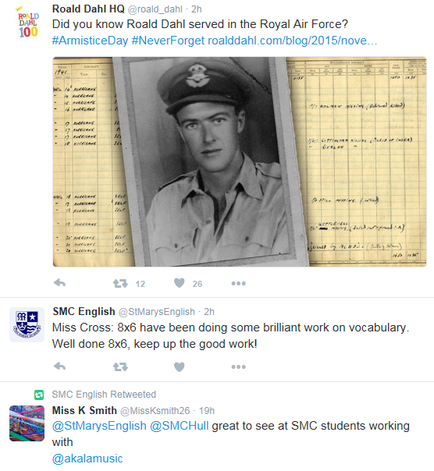
English at SMC: What can I do to support my child?
Revision strategies and techniques
Homework tasks
Revision guides
SMC English Twitter feed: @StMarysEnglish
World class thinking. World class achieving.

Slide 12
Humanities at SMC: Year 10 updates
Geography
Component 1: Examination on 3 out of a possible 11 Geography topics
Component 2: Examination on ‘problem solving’
Component 3: Examination on ‘fieldwork’ - shortened to 1 hour 15 minutes as no actual fieldwork was carried out. This paper is now all theoretical.
History
Paper 1: Medicine in Britain c.1250-present and The British Sector of the Western Front / WW1
Paper 2: The American West c.1835-1895. shortened to 55 minutes due to the removal of the 'Elizabeth' content.
Paper 3: Weimar and Nazi Germany, 1918-39
What will my child have to do in their exams?
World class thinking. World class achieving.

Slide 13
Humanities at SMC: What can I do to support my child?
Progress support sessions in History and Geography for selected cohorts on a Wednesday form time and Wednesday lunch
History and Geography revision: Tuesday lunch and after school. All are welcome to attend!
Weekly homework tasks
Revision guides
Post mock feedback
Ask your teacher for extra exam questions
SMC Geography Twitter feed: ​ @geography_smc
SMC History Twitter feed:
@SMCHistoryDept
World class thinking. World class achieving.

Slide 14
St Mary’s College
World class thinking. World class achieving.
Revision and exam preparation

Slide 15
Doing Your Revision
Active revision is the most effective way to revise – don’t just sit there, do something!
Revise with the exam in mind – practice exam questions, complete them in timed conditions.
Write your own revision notes – summarise the information you have to learn first.
Use your revision notes to test and re-test yourself.
Take advantage of technology – there are lots of great apps and websites to help you.
Take advantage of revision sessions in school.
World class thinking. World class achieving.

Slide 16
How should I spend an hour revising? By using the memory clock!

Slide 17
What is the memory clock?
This is our recommendation of how to spend each hour when revising.
Students can engage in ineffective revision which can limit their performance in examinations. Also, we are aware that it can be challenging to change students’ ingrained study habits. Therefore, we have designed a simple model to help clarify the most effective strategies and what these might look like over a period of an hour. It is our hope that this will help inform all students about the most effective strategies.

Slide 18
The memory clock explained...
Firstly review | Then practice | Finally check
The first part of the clock focuses on the process of reviewing what needs to be learned. Planning is important to ensure that students have time to cover all topics, and this includes the consideration of spacing out and interleaving revision, rather than mass-revising topics. The review should only be short. Avoid spending an hour reading and highlighting notes as this is called passive revision. Instead only spend 15 minutes reviewing a topic. | Possibly the most important part of the process, how are you supposed to know what topics you know if you do not test yourself? You should spend 15 minutes practicing a topic. Consider doing the following? Quizzes Self – testing through revision cards Completing practice exam questions (without your notes). Although initially you may not be very good, this is the most important part of the learning process. If you know you are poor at a topic you can allocate more time to it. | Finally you should check your work. This highlights the need for you to correct yourself. This supports your learning by identifying any misconceptions or mistakes that need to be changed in order to be successful.

Slide 19
Some examples..
GEOGRAPHY

Slide 20
ENGLISH
MVQ = multiple choice questions

Slide 21
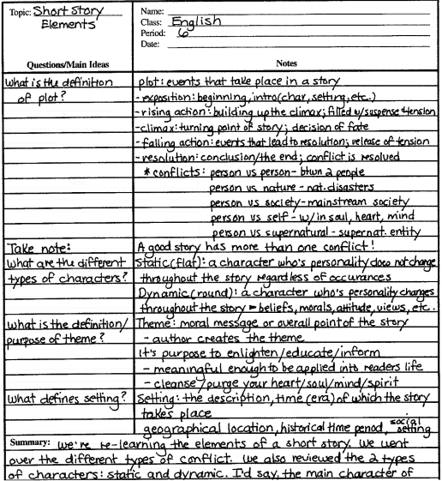
Condensing notes using the Cornell method.
Look at the example on the left or click below for a video explanation of how this works.
https://www.youtube.com/watch?v=ogHIyREqLd4

Slide 22
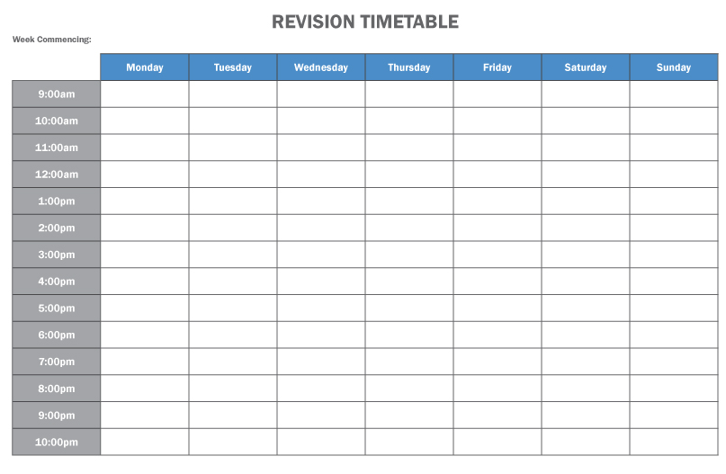
Create a Revision Timetable
What’s the point?
Avoids a last-minute rush
Sets up a routine and makes you discipline yourself
Allows you to share revision time between subjects
Ensures you keep on top of revision
Spreads out revision (avoids cramming!)
Creates a balance between revision and leisure time
Avoids time-wasting deciding what you’re going to revise.
World class thinking. World class achieving.

Slide 23
Create a Revision Timetable
How do I do it?
Divide up your day into sections, but plan in lessons, other study, clubs and importantly, social/relaxation time
Draw up a trial timetable and review it after one week. If it doesn’t work, redraft it.
Review your timetable at the end of each week
Put it somewhere prominent in your room
World class thinking. World class achieving.

Slide 24
Organising Revision Sessions
Make a topic checklist
Set a start and finish time and stick to it
Put your phone in a different room!
Exercise some self-control if using a laptop/tablet – an hour on Facebook does not equate to an hour’s revision!
Start with shorter sessions and build up to bigger ones
Take regular breaks
Reward yourself – give yourself something to work towards
World class thinking. World class achieving.

Slide 25
Online revision tools.
Quizzizz
Online quiz maker – can share with friends and test each other. Also many ready-made quizzes.
https://quizizz.com
Quizlet
Online flash card generator. Also lots of pre-made quizzes on a variety of curriculum topics.
www.padlet.com
BBC Bitesize
www.bbc.co.uk/bitesize. Lots of revision for a variety of GCSE topics
Oak Academy
https://www.thenational.academy/, The Government's national academy. Lots of lessons to help with revision.

Slide 26
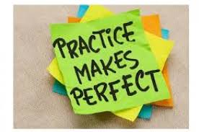
Other revision ideas.
Spaced Practice
Try to create mind maps of things you did last lesson, last week, last month. Where there are gaps, go through your notes and fill them in. Revise from your new sheet and repeat the exercise next week.
List of 10 – Go to the exam board's website and look at past papers. For each question, try to think of 10 things you would put in and why?
Bounce back – text your friends questions. If they get it right, they can "bounce back" a question of their own (or create a Quizzizz revision quiz for them to do).
Practice questions and exams. This is the best way. Do as many as you can. Create your own exam questions and answers – check them with your teachers.

Slide 27
Coping with Stress
Talk about it
Take time out to have fun
Exercise regularly
Think positively
Eat well and keep hydrated
Use breathing techniques to help you relax
World class thinking. World class achieving.

Slide 28
How can parents and carers help?
Discuss with your child how you could help them
Provide the right environment for success – quiet and well-lit if possible
Give plenty of praise and encouragement
Keep your child well supplied with food and drink
Be prepared to listen
Encourage regular breaks during long periods of revision
Encourage morning revision over late evening revision – brains tend to be more receptive in the morning
World class thinking. World class achieving.

Slide 29
World Of Work
(WOW)
Second week in July for Year 10
Due to the Covid-19 pandemic, work experience is not likely to be a viable option for this year’s cohort of Y10 students.
Nevertheless, there is a still a need to prepare our students for the career path that lies ahead of them and hopefully help them feel equipped to make their first steps into the workplace.

Slide 30
Whilst it is impossible to replicate the experience of spending time in the workplace, we can endeavour to give students an insight into the world of work and help them to understand themselves and the types of study and work that may suit them in the future.
With this in mind, we are planning a World of Work [WOW] focus week, supported by a bank of online and virtual work experience resources, substituting some of the experience they should have received.

Slide 31
Our WOW focus week will include supporting students to:
Profile themselves and consider their strengths and aptitudes
Investigate Career Pathways
Prepare for Year 11 and Beyond
Explore Labour Market Information
Observe A Day in the Life of…

Slide 32
How will it work?
Some of the sessions will be delivered during class time, whilst others are designed to be completed in the students own time so they can build the experience they want.
In addition, all students have a login to our Unifrog careers platform which will help students to use, develop and enhance their research skills, and apply those skills in their study programmes.

Slide 33
Unifrog
Unifrog is our new online resource. It helps students plan their future by bringing all the available information into one single, impartial, user-friendly platform. It supports and enables students to make the best choices and submit the strongest CVs, UCAS and job applications.
www.unifrog.org

Slide 34
Careers e-Library
https://nationalcareersservice.direct.gov.uk/job-profiles/home - look at the "Job Profiles" section. Factual up to date information about careers.
http://www.bestcourse4me.com/ - gives help with "A" level, degree and career choices.
http://www.careerpilot.org.uk/ - gives help with choices at 14, 16 and beyond.
http://www.icould.com/ - general careers advice and short careers film clips.
http://www.tomorrowsengineers.org.uk/ - information on everything to do with engineering careers.
http://www.apprenticeships.org.uk/ - access to the national apprenticeships database and general information.
http://www.ucas.com/ - all university information and websites.
http://www.careersbox.co.uk/ - short careers film clips.
http://www.russellgroup.ac.uk/ - to access 'Informed Choices' booklet which gives definitive information on GCSEs, 'A' Level and I.B. subject choices.
https://www.unifrog.org/student
http://movingonmagazine.co.uk/
https://successatschool.org/advice/subjects

