Slide 1
Home Teaching & Learning
Microsoft Teams

Slide 2
How can I carry on learning if I’m not at school?
There may be several reasons why you may not be attending St Mary’s College each day. These include;
Feeling unwell; or self isolating due to you or a family member having Covid 19 symptoms or having been contacted by the national Track and Trace scheme.
A partial closure of the school.
Another lockdown or whole school closure.
If any of these did occur, your learning will continue.

Slide 3
Self Isolating
If you are self isolating / feeling well enough, you can keep up with your classes by completing the work set within Microsoft Teams files.

Slide 4
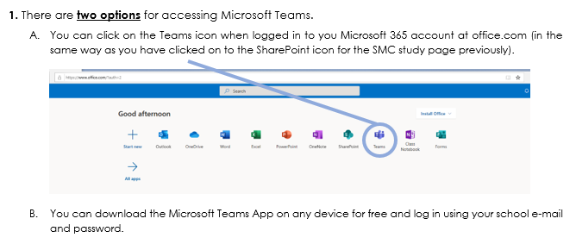
Guidance for accessing Microsoft Teams

Slide 5
You will find lesson resources in the file section
Click on the word ‘Files’

Slide 6
Find click on the correct week number & the date that week begins – these match your planner

Slide 7
Click on ‘Lessons’ if you are looking for resources, or ‘Homework’ if something has been set using Teams.

Slide 8
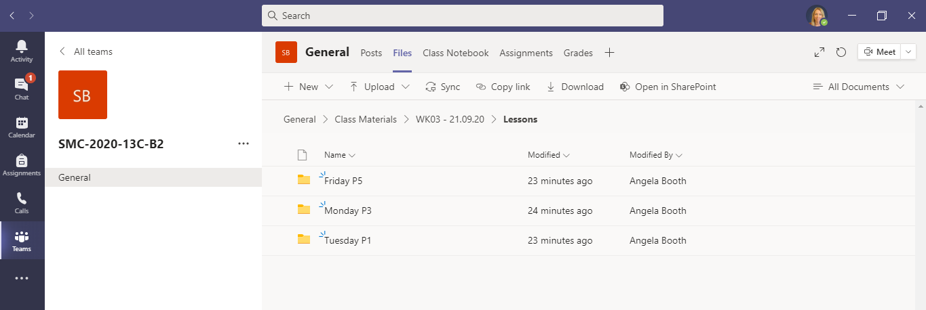
Find the correct day and lesson folder

Slide 9
Click on the resources for the lesson
You should read the PPt / notes carefully and complete all available tasks to the best of your ability. You can contact your teacher through Teams if you need any additional help or guidance, but remember they will be teaching lessons so may take some time to respond.

Slide 10
Partial or Full Closure
If there is a partial closure, this may mean one or more year groups cannot attend school and/or not all at the same time.
Your teachers would then deliver your lessons, Live on Microsoft Teams. This would also be the case if we had a full school closure.
The next few slides will explain how to access these Live lessons on Teams.
You will also have a paper copy of the guidance.

Slide 11
Guidance for accessing ‘live lessons’ through Teams

Slide 12
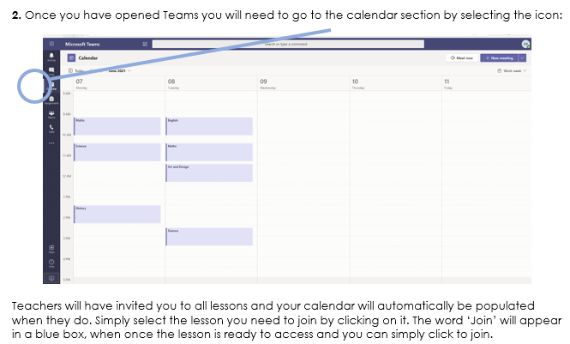
Guidance for accessing ‘live lessons’ through Teams

Slide 13
Guidance for accessing ‘live lessons’ through Teams

Slide 14
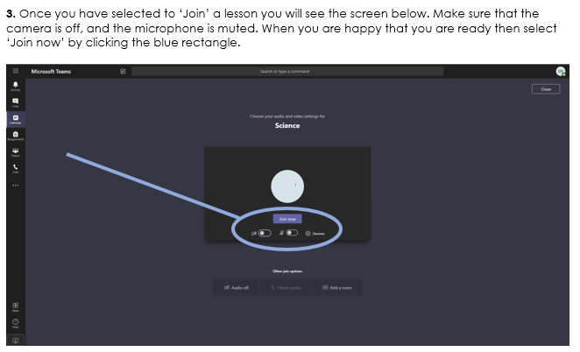
Guidance for accessing ‘live lessons’ through Teams

Slide 15
Guidance for accessing ‘live lessons’ through Teams

Slide 16
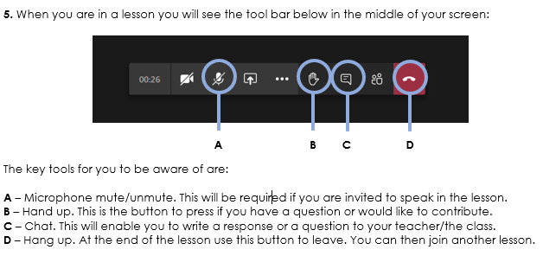
Guidance for accessing ‘live lessons’ through Teams

Slide 17
Guidance for accessing ‘live lessons’ through Teams

Slide 18
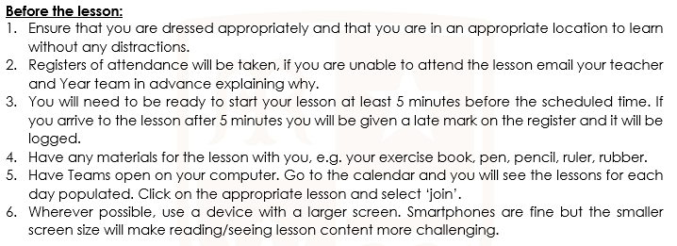
Student Expectations For Live Lessons

Slide 19
Student Expectations For Live Lessons

Slide 20
Your education really matters. We will do all we can to ensure you always have the best possible opportunity to learn at St Mary’s. We need you to play your part.

